Slide 1
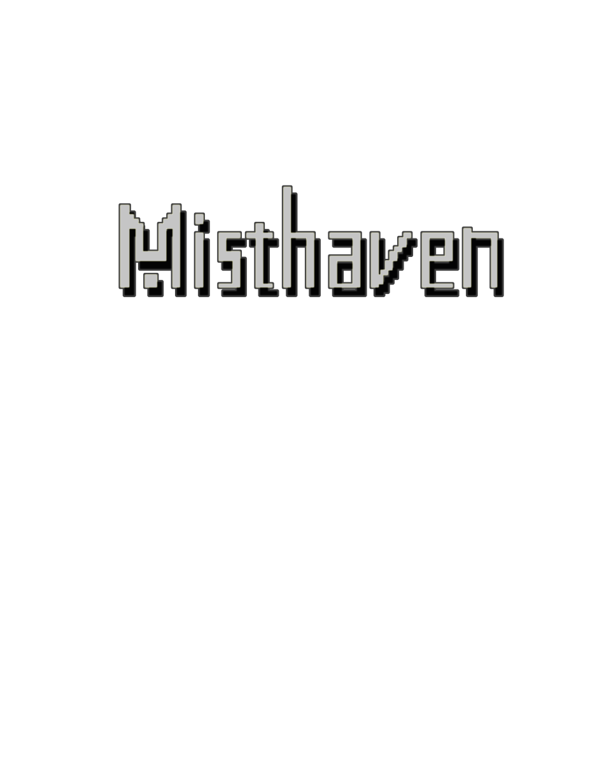
Once upon a time in
A Pixel Brothers Marketing Presentation

Slide 2
Who are the Pixel Brothers?
The Pixel Brothers are a 6 man team of game developers, working on their game “Once upon a time in Misthaven” or “Misthaven” for short
The team consist of: Aaron Alphonso Donald Smith Thomas Whiting Usman Variava Rehan Rameez Eric Chan

Slide 3
What is Misthaven?
Misthaven is a hack and slash adventure game inspired by older Nintendo games such as Legend of Zelda and Pokémon.
Set in the world of Misthaven after a planetary cataclysm, you play as a hero trying to save his people from being sacrificed to the dragon that has destroyed the world.
Features a story that will have players emotionally attached to the characters and events.

Slide 4
Who would want this game?
Our focus target audience is towards the people who enjoy the following:
Heavy story
Emotional attachment
Hack and slash elements
8-bit visuals
Fictional story
Scenery
Retro throwback

Slide 5
Where can we get this game?
The game will be available in the following distribution markets:
Steam
GOG.com
Indie Game Stand
Desura
Indie bundle stores such as the Humble Bundle, Indie gala and bundle star. These will be considered in the future once the game have been released.
We are also considering porting the game to Mobile devices such as Android, iPhone and Windows phone should the game have a successful launch.
Misthaven will be distributed via ITunes, Google Play and Windows Phone app for mobile devices.

Slide 6
How will we create awareness of the game?
One of the ways we can create awareness of our game is to have it advertised in major PC gaming websites such as PCGamer or Indie Static
Another way that we can advertise the game is through gaming channels on youtube with people like Total Biscuit, Projared and FarFromSubtle
On mobile devices, we will be advertising the game through in app advertisement for other games as well on websites such as Face Book.

Slide 7
Strengths of the team
The team can help each other out by splitting up the work load for multiple people
Each member of the team is specifically tasked to work on a certain part of the project
Since our team is small and independent, we can work without any form of pressure from publishers.

Slide 8
The Team’s Weaknesses
For a small team, making a game requires large amount of work and time.
Despite having to work together, each person has their own strengths and weaknesses, which can affect the progression of the development in bad ways
Due to the constraints place upon us there is no punishment aside from peer reviews near the end of the term where the damage of a team mate not contributing is already done.

Slide 9
How much will the game be?
Because the game is independently made, it should be considered that the game should be marketed for $9.99 at the max.
Increasing the price would most likely turn away a lot of people
We will not make any form of micro transaction or downloadable contents.

Slide 10
Why on PC?
The PC houses the largest amount of gamers than any other platforms
PC’s allow for more accessibility for players than consoles do. This includes control customization, system requirements and mobility
PC’s also allow us to update our game more efficiently than on consoles
Games can be played without requiring online services and DRM that consoles would usually have

Slide 11
Why on Mobile next?
In terms of market shares based on mobile devices, Android and iPhone altogether takes up 92% of the smartphone market as well as 91% of the tablet devices as well.
On top of that, the numbers of gamers on mobiles, including casual gamers, have been increasing ever since as well.

Slide 12
Hazards of PC
Piracy is the biggest issue when releasing games on PC as it can harm the sales of Misthaven
Like other PC games, Misthaven is digitally released only and will require online access to purchase the game
Sites such as GOG.com do not offer auto updates and will require players to reinstall the game for every update

Slide 13
Our Analysis on Marketing: Competition
The expected competitors of Misthaven are other types of indie games, some of which share similar aspects as Misthaven does
When asked about stacking up Misthaven to other competition, Misthaven will offer both a visual and a story telling advantage over the other independent games that are available.

Slide 14
Our Analysis on Marketing: Advantages
One of the advantages that Misthaven will have over the competitors is the game, while being inspired by older Nintendo games, captures the feel of those games and can show a large amount of appeal towards the target audience
Another advantage is that Misthaven has a lot of story telling as it is is heavily focused on the game’s story and lore

Slide 15
Our Analysis on Marketing: the 4 Ps
Product: the hack and slash adventure game Misthaven
Price: the price of the game will be marketed on PC for $3.99 dollars. The mobile version of the game will be marketed for
Place: On PC, the game will be distributed on Steam, GOG.com, Indie Game Stand and Desura. On mobile it will be distributed via Google play, Itunes and Windows Phone app.
Promotion:

Slide 16
Brand of Pixel Brothers
The Pixel brothers is associated with adventure type games because the developers enjoy adventure games themselves
The Brand message of The Pixel brothers is to make throwbacks to older games, while still keeping the modern appeal

